Slide 1



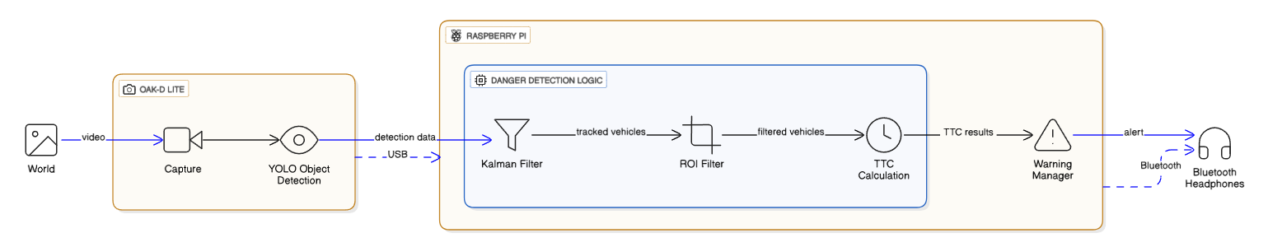
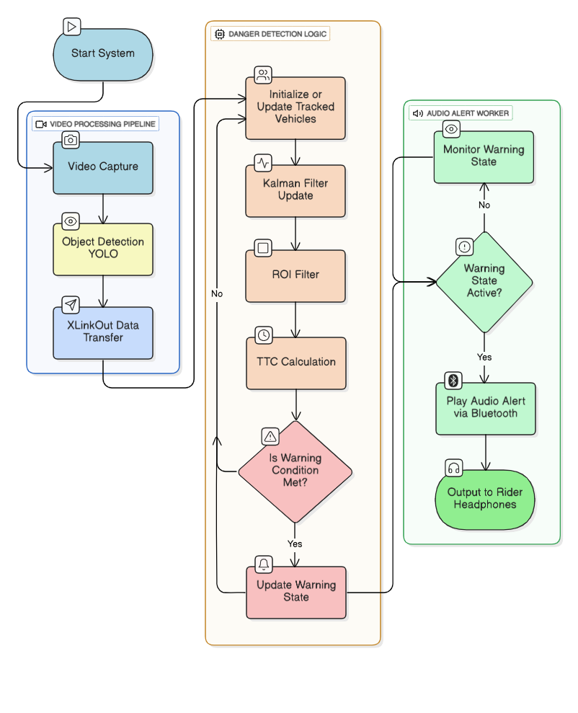
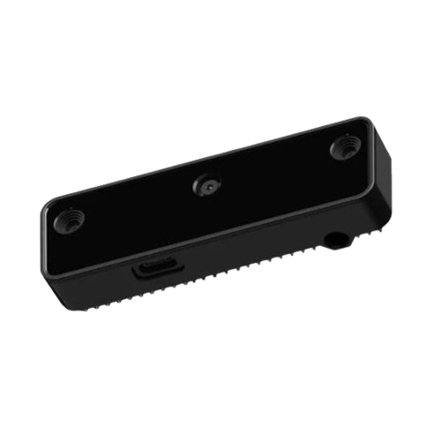
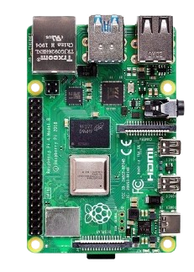
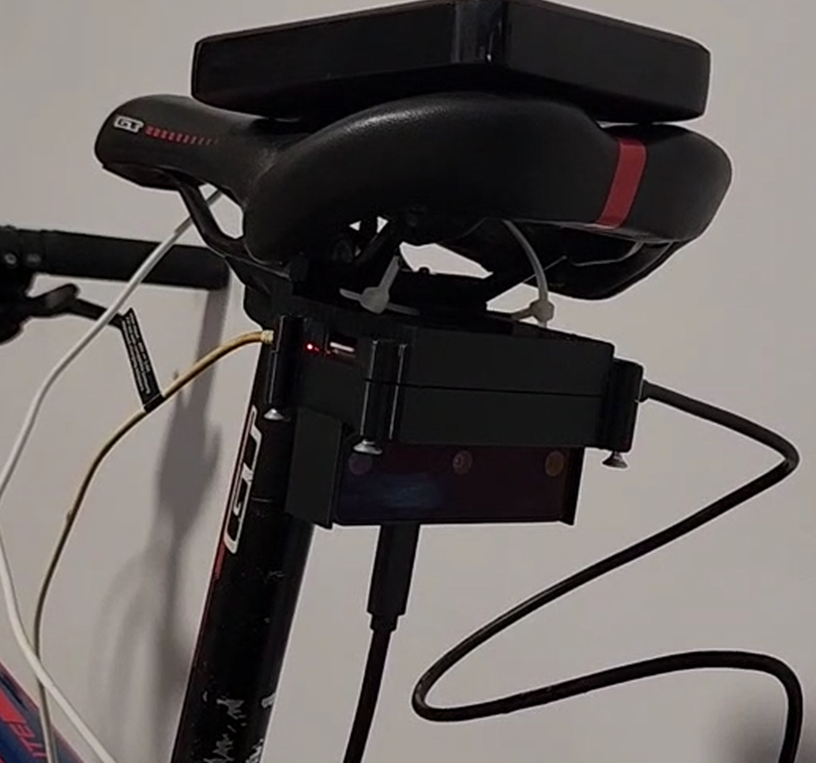
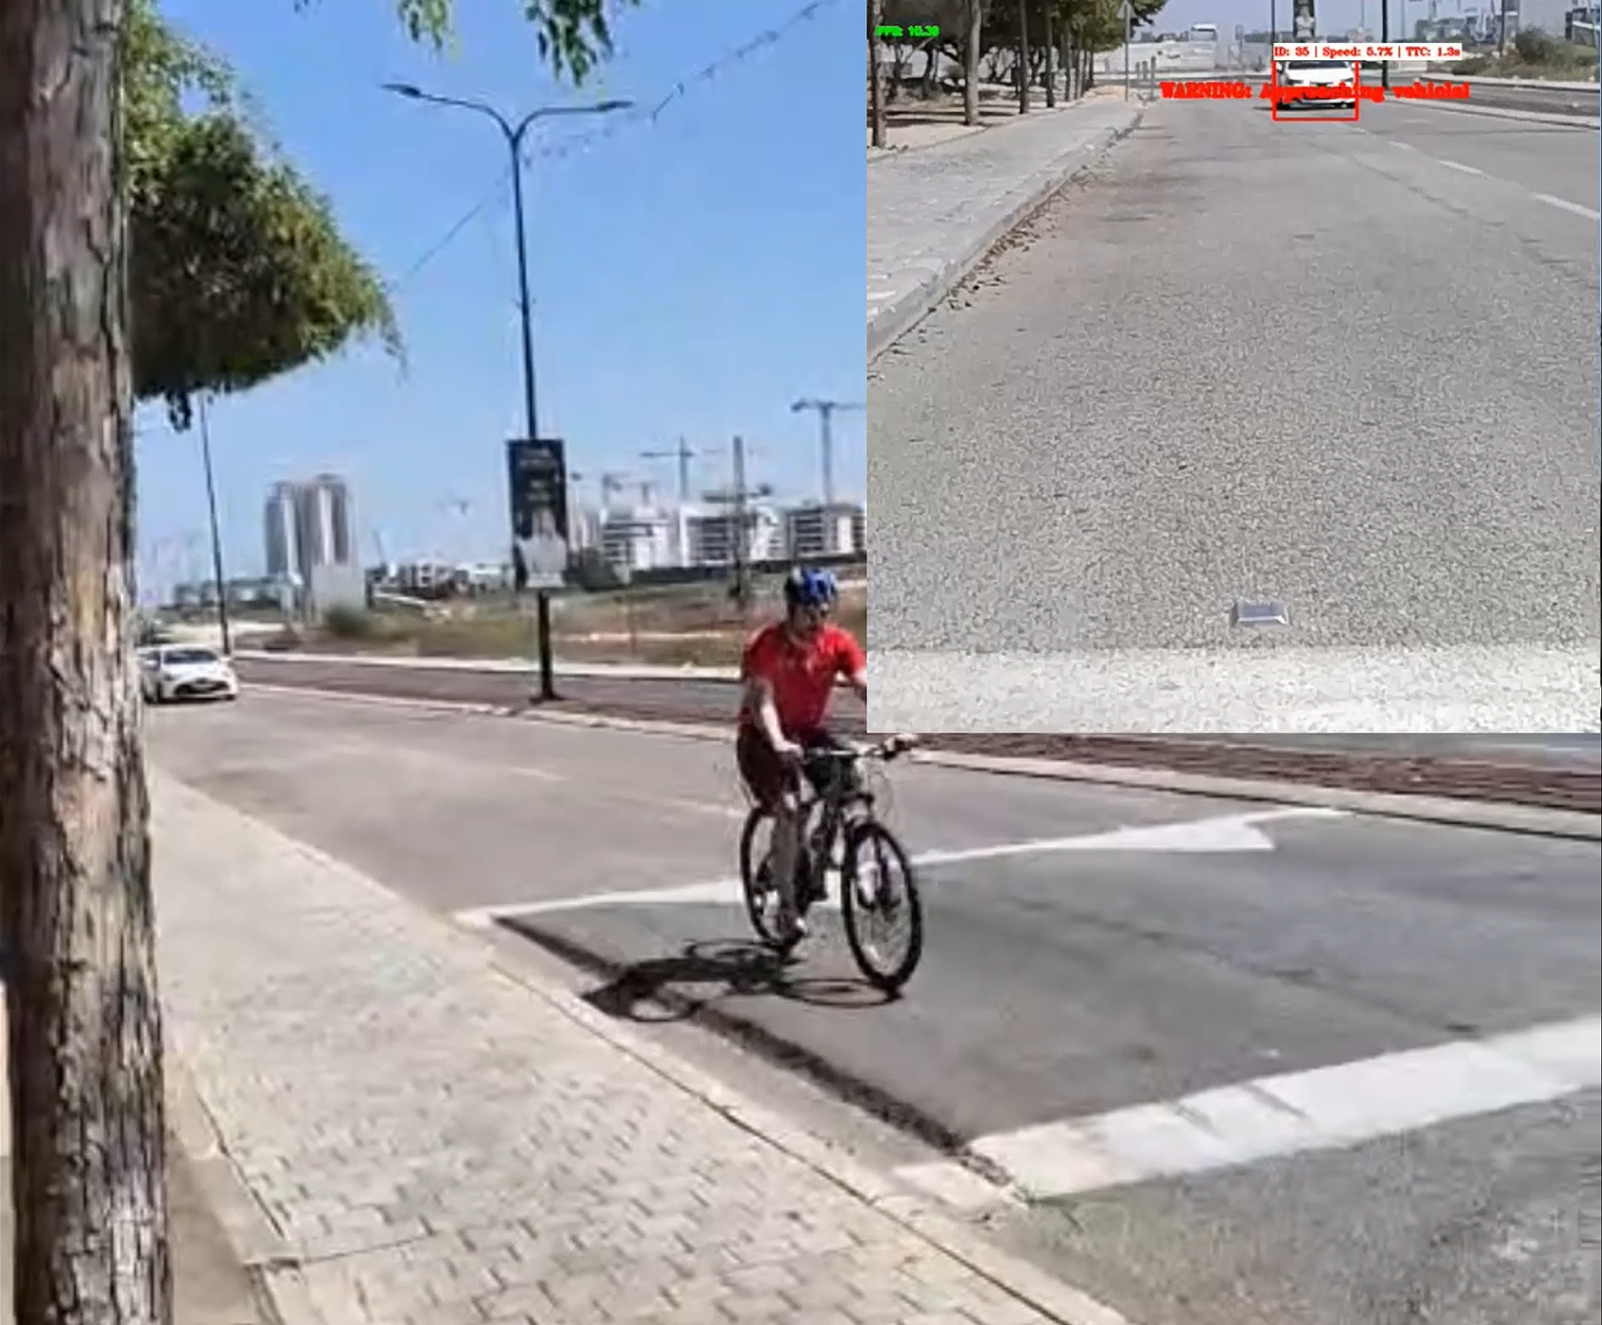

Bicycle Mobileye
A Computer Vision System for Cyclists Safety
הפרויקטים הכי מבריקים בפקולטה
Ron Lebedinsky and Ori Gross, Supervised by Koby Kohai
CRML, Faculty of Electrical and Computer Engineering, Technion
Problem
Solution
Cyclist safety gear is stuck in the past - helmets and lights offer passive protection but leave riders completely unaware of vehicles approaching from their critical rear blind spot.
Implement an intelligent warning system that provides real-time audio alerts about vehicles approaching from behind. We harness on-device AI to transform cyclist safety: moving from passive protection to active awareness and providing the critical reaction time needed to prevent a collision
System Architecture
Requirements
System Algorithm System Components
Compact
Mountable
OAK-D Lite (~150$)
Cost-Effective
Alerting Threats
AI-enabled
Depth perception
On-device neural inference
Compatible with Python
Low Latency
Results
Raspberry Pi 4b (~100$)
Assembled System:
Linux-based OS
Well-documented
large developer community
Compatible with Python
Accessories
Bluetooth earbuds (~30$)
Power bank (~20$)
3D printed case (~1$)
Total System Cost: ~300$
Detection and warning in real-time:
Challenges
Future Work
Accurate vehicle detection
Develop phone application for easy integration
Refine the casing for better resistance to water, vibration, heat
Develop online solution with better and heavier detection models
Used images from the Open Images Dataset
Trained a YOLO-based model for real-time vehicle recognition
Reliable danger detection system
Developed a custom algorithm inspired by "Forward Collision Warning with a Single Camera“ article
False detections caused by irrelevant objects in the frame
Added a Region of Interest (ROI) filter to focus only on relevant road areas
For the full technical details and code implementation check our GitHub repository:
Unstable detection bounding boxes
Implemented a Kalman Filter to stabilize bounding boxes

